Slide 1
Welcome to F2 Reading Meeting
Julie Doyle – Reading Recovery Teacher, Reading Lead and Assistant Head Teacher
Lora Thorley - EYFS Lead and F2 Class Teacher

Slide 2
How we teach your child to read: Phonics
Sounds for each phoneme (letter of the alphabet, pure sounds)
Moving onto learning the diagraphs/trigraphs
Actions and rhymes for each of these
Phonics is essential in reading and writing. (Blending and segmenting)

Slide 3

Rocket Phonics
Phonics books will contain phonemes, diagraphs/trigraphs that the child has been taught in a phonics lesson.
Books will also contain some common exception words. These will have also been taught during class phonics lessons.

Slide 4

How to read a phonics book with a child
Book intro
Look at common exception words
Remind child that they will need to use their phonics when reading
Remind child of the ‘focus’ diagraph, trigraph- can they tell you the action rhyme that goes with it?
Child reads, one or two pages only- gives lots of praise!

Slide 5
Top Tips
Encourage, “if you know it say it, don’t sound out words you know”
If the reading is very slow encourage them to re-read the sentence with fluency- it is fine to model it
Less is more - A page or two is fine if it is very slow!
Encourage independence – pointing and page turning!

Slide 6
Expectations
Children should be reading at least 4 times a week at home
Children in F2 should have a phonics book and are encouraged to take a reading for pleasure book to share at home.

Slide 7


Slide 8
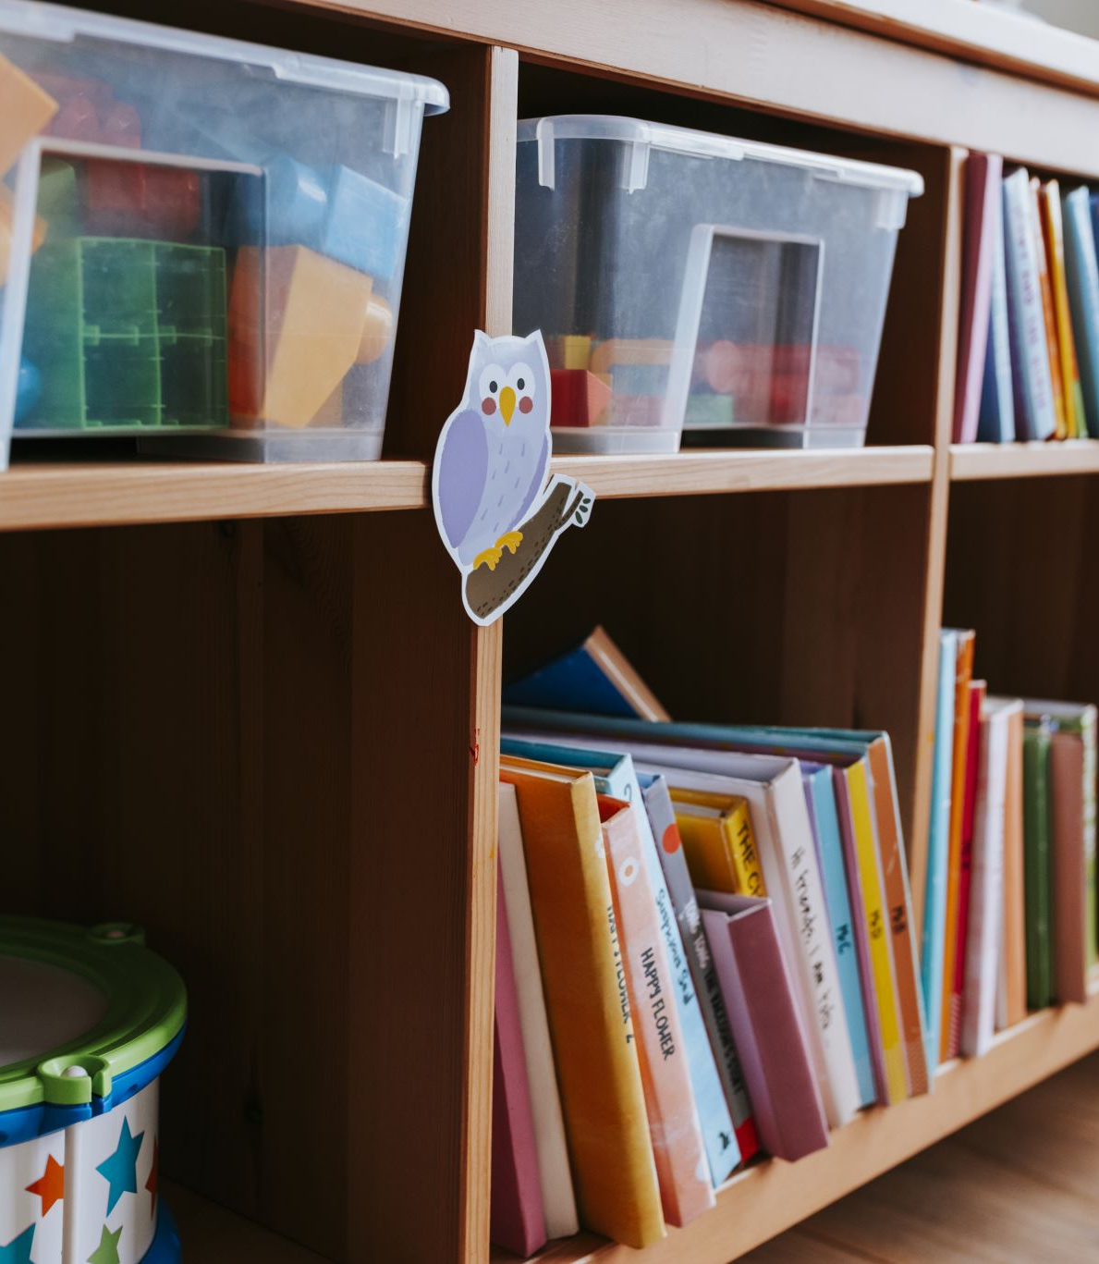
We are a Reading School…Everyday is book day!
Daily story time
School library
Books and bagels
Book swap
Outdoor reading areas
Buddy reading
Reading newsletters
Epic reading
Visits to local library
Book Club
Librarians
RfP books shelves/areas
Reading Events (Story tent, author visits, Reading Festival, Book Café, Poetry Week and more…)
Reading Recovery and Reading interventions and Reading volunteers

Slide 9

Any Questions?
Please ask if you need any support, or have any questions about how best to support your child with their reading at home.

